Slide 1
N
Welcome to Navoi
Oasis of successful business

Slide 2
Uzbekistan is a rapidly growing market
Population > 36 mln people
> 15 US$ Import of manufactured goods**
GDP Per capita 7735 US$*
Area 448.9 thousand sq km
Strategic position
in the heart of Central Asia
Developed infrastructure
Skilled workforce
Liberalization of economic legislation
Political stability
* PPP
** in 2023

Slide 3
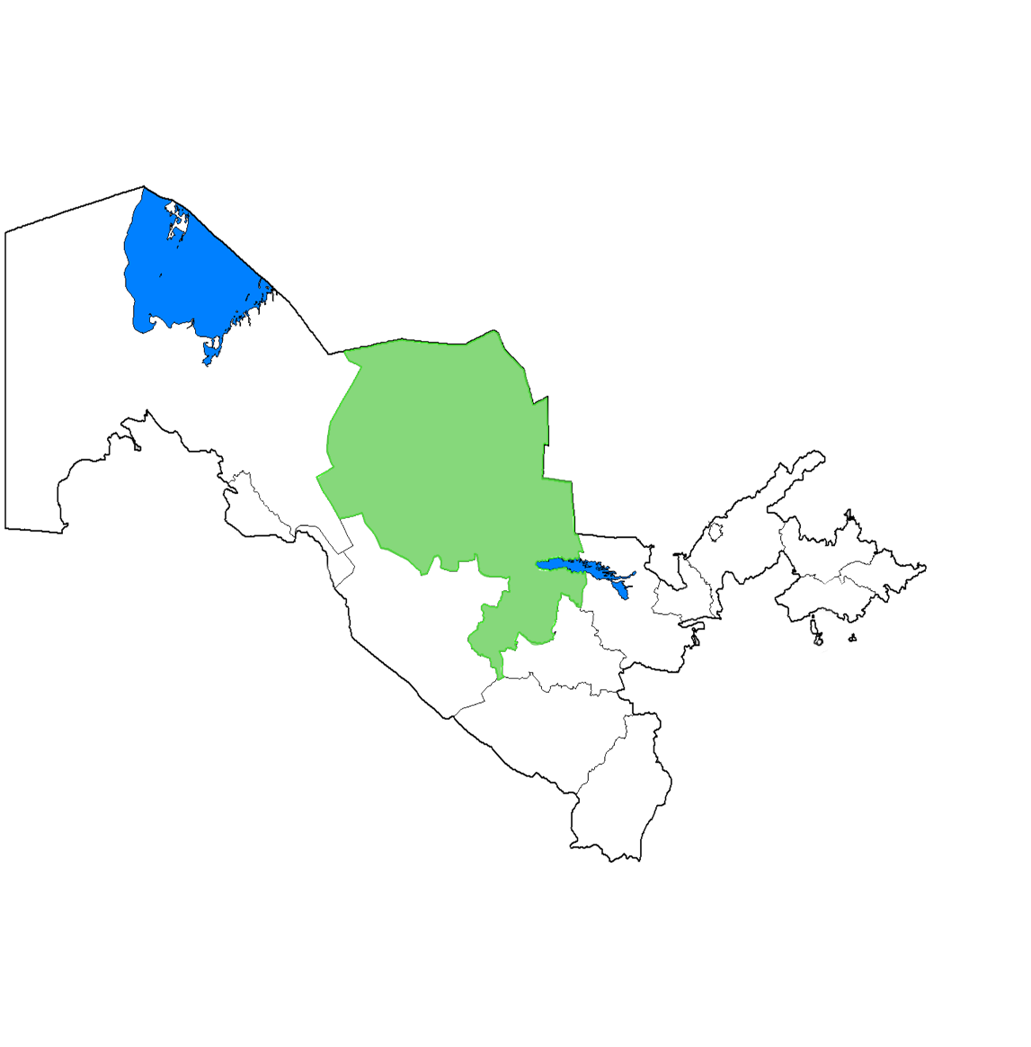
Navoi Free Economic Zone – Overview
Navoi region
Navoi FEZ – the first FEZ in Uzbekistan
Kungrad
Moynaq
Nukus
Uchquduq
Namangan
Tashkent
77 launched industrial projects
Urgench
Navoi
Andijan
Bukhara
Gulistan
Fergana
Jizzakh
Samarqand
Located in the geographical center of the country
Qarshi
Termez

Slide 4
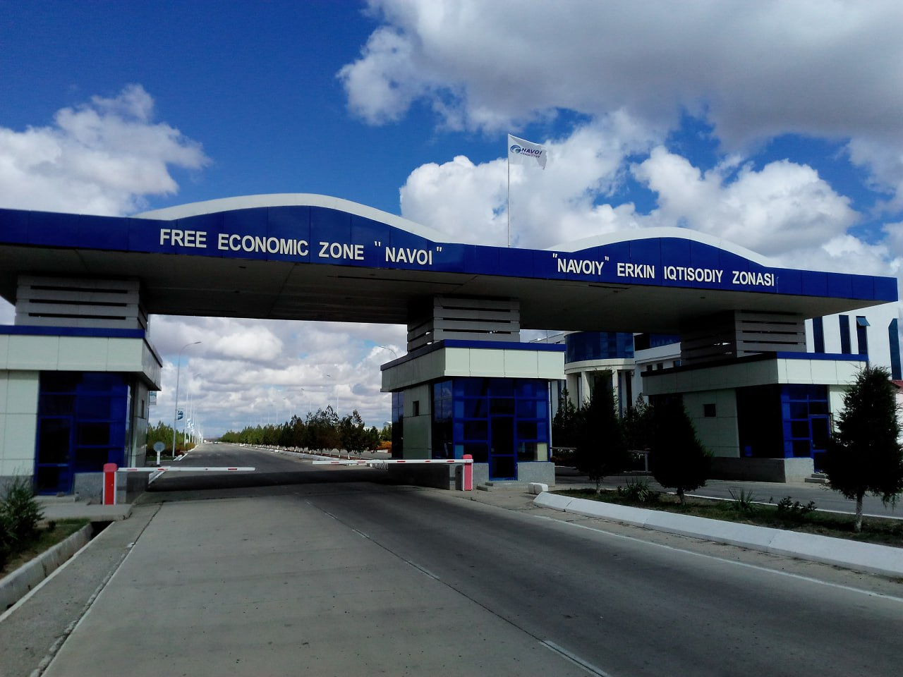
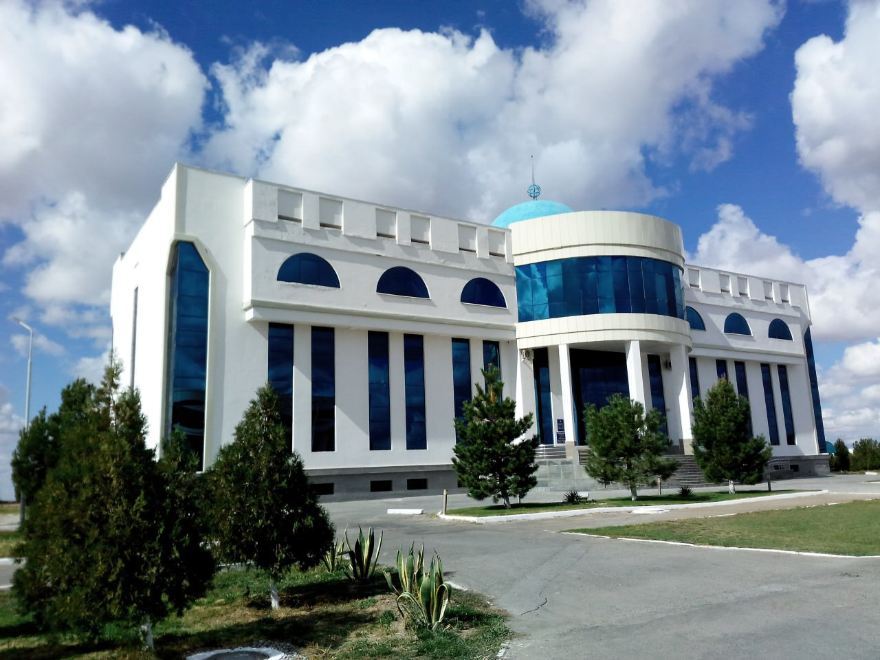
Navoi FEZ – Overview
High-quality technical infrastructure (electricity, gas & water supply, roads)
Rich deposits of mineral resources
77 launched industrial projects, 28 projects under construction
Qualified manpower based on local industrial background
Industries: chemistry, mining & processing, building materials, electrical appliances, metal works, automotive parts etc.

Slide 5
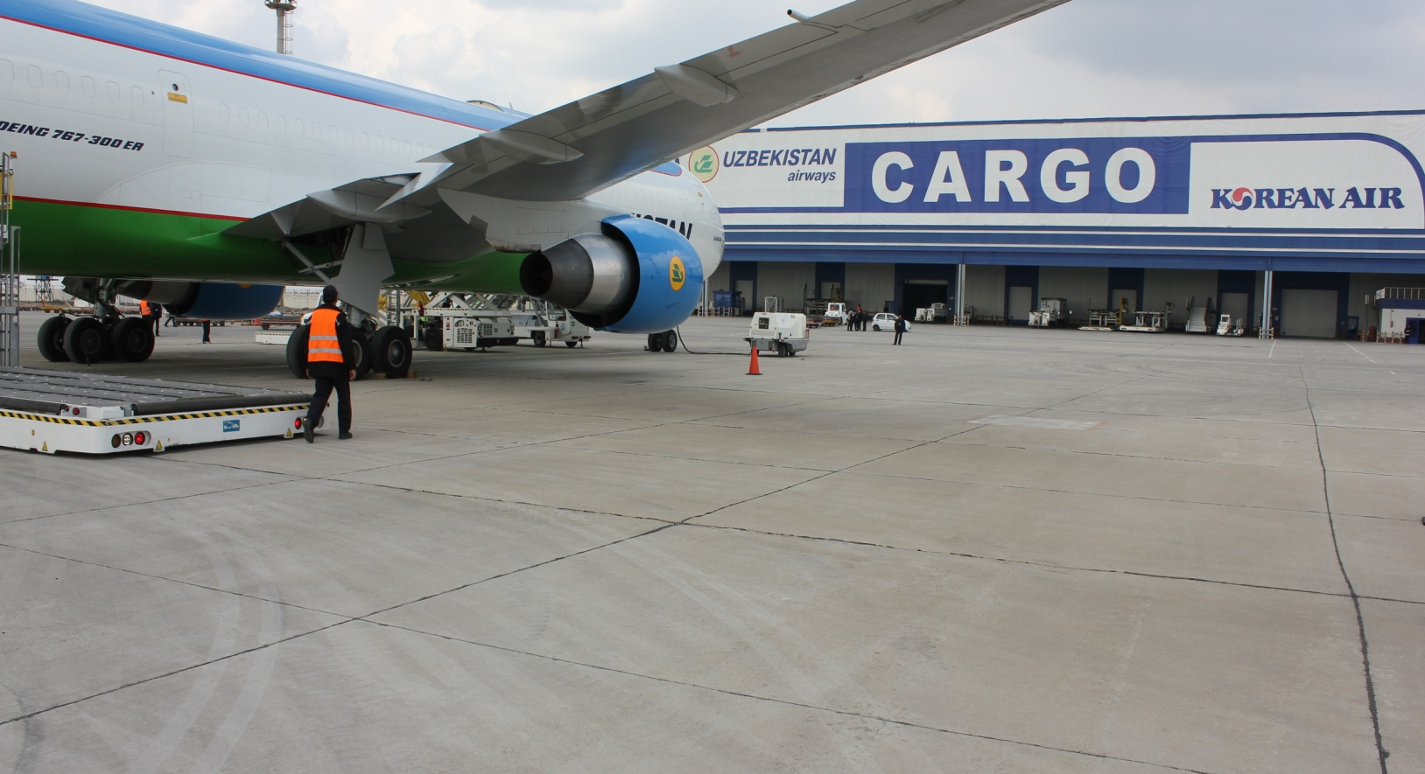
Navoi FEZ – multimodal logistics hub
International airport:
- Runway - 4000 m., width - 60 m.;
- largest cargo terminal in Central Asia;
- double corridor system (“red” and “green”).
Railway junction inside the FEZ, with an area of 5 hectares
National motorway

Slide 6
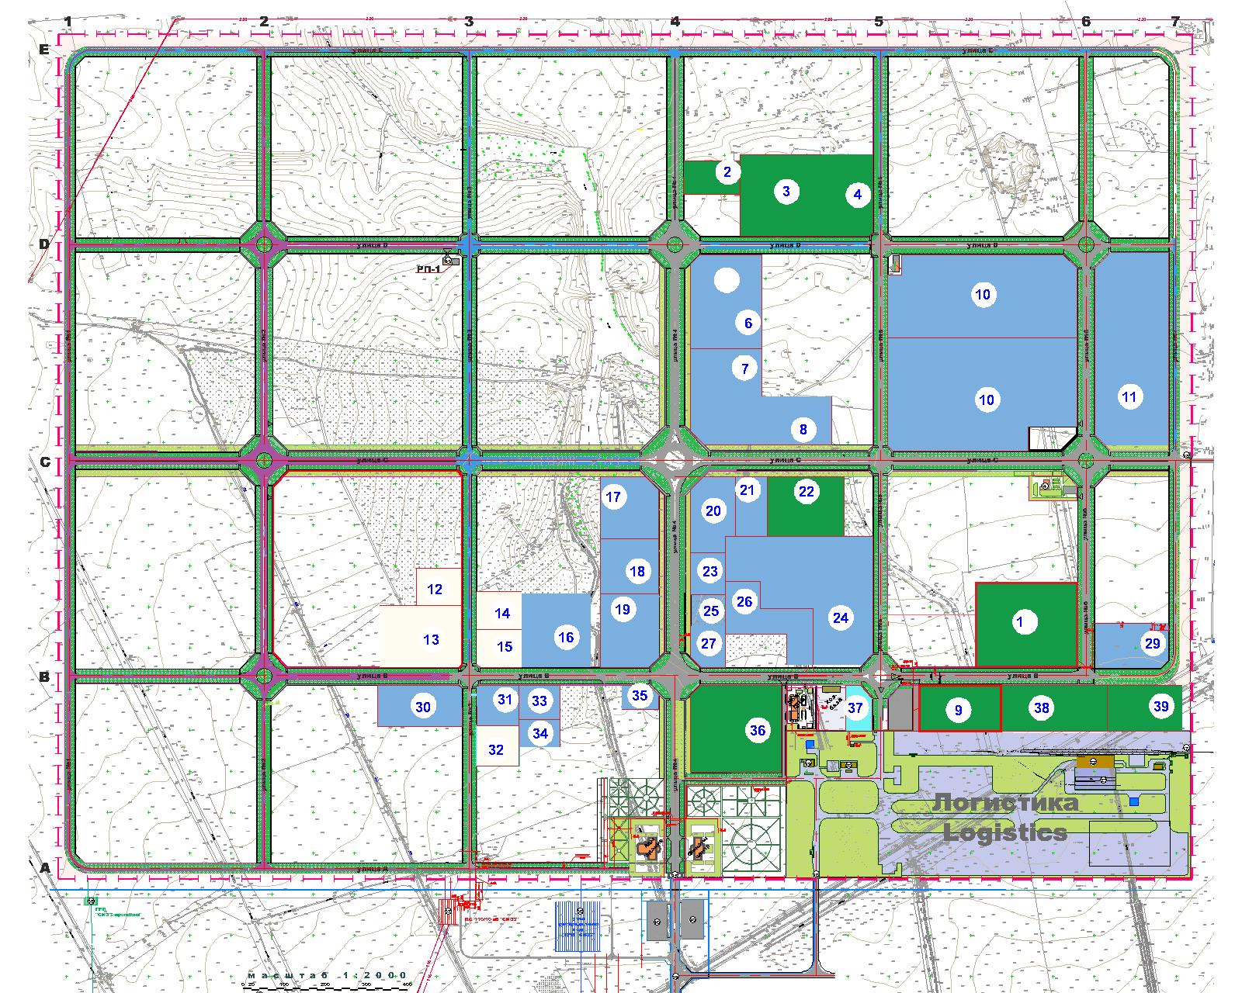
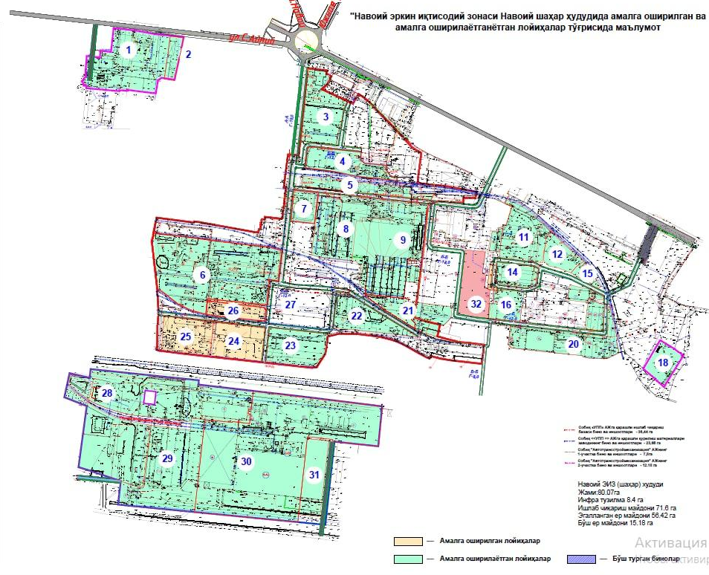
Navoi FEZ Industrial sites
Any place within the limits of the Navoi province
Karmana district, 564 ha
Navoi City 81 ha
Note: only free state-owned lands are meant

Slide 7
Advantages
Tax reliefs
Customs preferences
Export and sales support
tax incentives for up to 10 years
0% Property Tax
0% Land Tax
0% Water Consumption Tax
0% Profit Tax – for projects with cost over USD 3 mln
0% Import duties on raw materials/components if the finished goods are exported
up to 120 days of postponing for payment of customs duties and VAT in other cases
We assist in obtaining state export support measures and help to find foreign customers. We also provide support in defining domestic sales opportunities.
Access to high quality infrastructure
Administrative, legal and accountancy services
Simplified allocation of land plots
A simplified procedure to get a FEZ resident status
electricity, gas, water
If compared to all other FEZ in the country

Slide 8
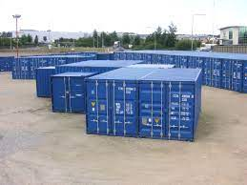
Who can become a Navoi FEZ resident?
Industrial or high-tech projects
Foreign trade companies
Logistic companies
Industrial services companies
Project cost > USD 300 thousand
Any export-oriented projects (f.ex. including greenhouses) projects
Project cost > USD 300 thousand
NOTE: the project cost includes the worth of the equipment, construction and raw materials or components.

Slide 9
How to become a Navoi FEZ resident?
Submit the application and your project’s business plan
Pay the admission fee (1200 euros)
The procedure takes no more than 10 days from the date your application is accepted
NOTE: we can provide assistance in preparing the application.

Slide 10
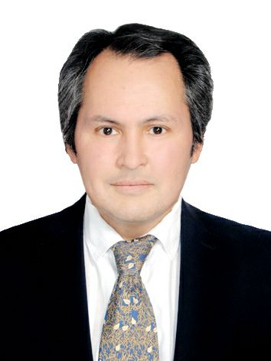
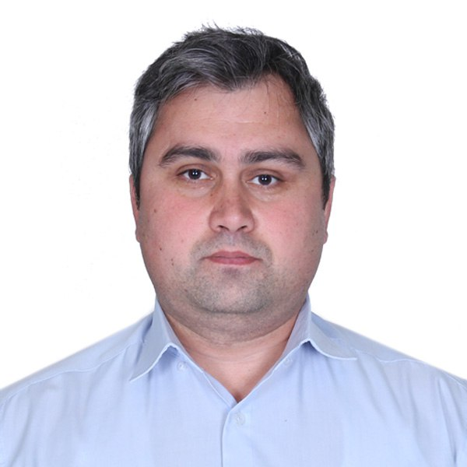
Contacts
Khabib Abdullaev
CEO
+998 90 925 4624
ceo@feznavoi.uz
Nazirjon Juraev
Deputy CEO
+998 93 182 7055
nazirjuraev@yahoo.com
Welcome to Navoi!

